Slide 1

Amazon sales project report

Slide 2
Introduction
Objective: To Create Amazon sales Dashboard & stories.
Scope: Perform Analysis from Amazon data using Power Bi.
This dataset is having the data of 1K+ Amazon Product's Ratings and Reviews as per their details listed on the official website of Amazon.

Slide 3
Features
product_id - Product ID
product_name - Name of the Product
category - Category of the Product
discounted_price - Discounted Price of the Product
actual_price - Actual Price of the Product
discount_percentage - Percentage of Discount for the Product
rating - Rating of the Product
rating_count - Number of people who voted for the Amazon rating

Slide 4
Features
about_product - Description about the Product
user_id - ID of the user who wrote review for the Product
user_name - Name of the user who wrote review for the Product
review_id - ID of the user review
review_title - Short review
review_content - Long review
img_link - Image Link of the Product
product_link - Official Website Link of the Product

Slide 5
KPI(Key Performance Indicator)
Actual Price.
Discount Price.
Profit Price.
Product Rating.
Number of rating counts.
Discount percentage.
Total number of category.
Actual and Discount price comparison of product.
Top 10 discount product.

Slide 6
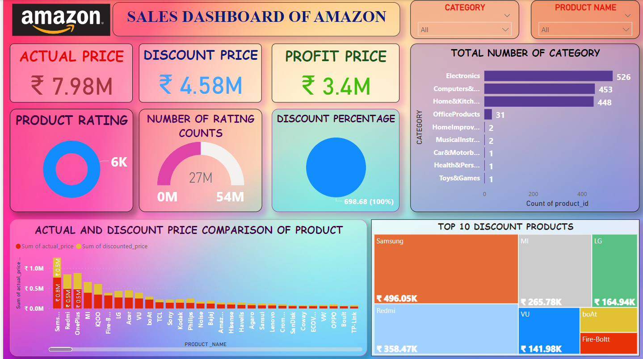
Power BI Dashboard

Slide 7
Story of Project
Amazon is an American Tech Multi-National Company whose business interests include E-commerce, where they buy and store the inventory, and take care of everything from shipping and pricing to customer service and returns. I've created this dataset so that people can play with this dataset and do a lot of things as mentioned below.
dataset Walkthrough
Understanding Dataset Hierarchy
Data Pre-processing
Exploratory Data Analysis
Data Visualization
Making Recommendation System
This is a list of some of that things that you can do on this dataset. It's not definitely limited to the one that is mentioned there but a lot more other things can also be done.

Slide 8
Conclusion
Implemented Tools to Convert data into Useful graphical form of output by generating Dashboards in Power BI.

